Slide 1

Identity and Security Management
Module 12

Slide 2
Chapter Overview
In this chapter, we'll go through the following topics:
Microsoft Identity
AAD
Users and groups
Hybrid AAD
Conditional Access
BitLocker disk encryption
Self-service password reset
AAD password protection
Password-less authentication
What is and isn't supported in each password-less scenario
Microsoft Defender for Endpoint

Slide 3
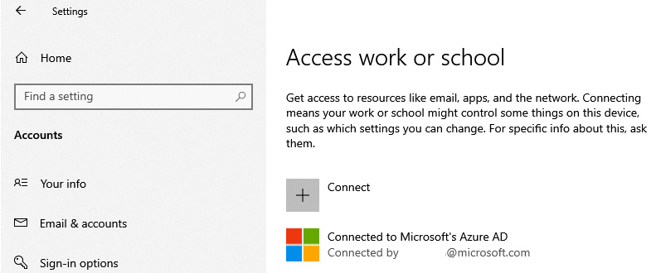
Microsoft Identity
Notes:
Microsoft Identity
Active Directory Domain Services (AD DS) has been on the market since the year 2000. As some of you might remember, it arrived with the first release of Windows 2000 Server.
The way it works is, you join your Windows client or server devices to Active Directory (AD) to take over the management layer of it via either group policies or security settings, or you use it to chain different AD environments to each other to delegate organization permissions to resources that are stored in a different AD environment – in different forests.
Within the context of Microsoft Endpoint Manager (MEM), it's possible to connect to Windows devices that are both AD DS- and AAD-joined. Devices that are joined to AD DS and need to become available in AAD as well are known as hybrid AAD-joined (HAADJ). Before your business is ready to work natively in AAD, hybrid AAD might be the best option to use as an interim solution. Let's talk more about this in the next sections of this chapter.
If your devices are enrolled into AAD directly and listed in All Devices within MEM, you can see the AAD domain properties in your Windows 10 Enterprise Settings menu.

Slide 4
AAD
AD (AD DS) and makes it possible to do the following:
SSO simplifies access to your apps from anywhere.
Conditional Access and MFA help to protect your environment from outside intruders.
As a single identity platform, it lets you engage with internal and external users more securely.
Developer tools make it easy to integrate identity into your apps and services.
Let's look at AAD users next.
Notes:
AAD
AAD provides single sign-on (SSO) and multi-factor authentication (MFA) to Windows 10 Enterprise and MEM to help protect your users from 99.9 percent of cybersecurity attacks.
AAD is the evolution of traditional AD (AD DS) and makes it possible to do the following:
SSO simplifies access to your apps from anywhere.
Conditional Access and MFA help to protect your environment from outside intruders.
As a single identity platform, it lets you engage with internal and external users more securely.
Developer tools make it easy to integrate identity into your apps and services.
Let's look at AAD users next.

Slide 5
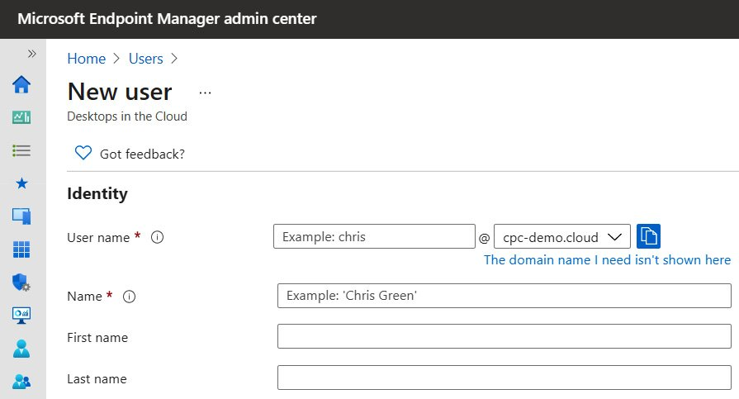
AAD users
Notes:
AAD users
AAD users include the account settings of a user in your organization and only live in the Microsoft Azure cloud. Creating and deleting users can be done by using either the AAD Global Administrator role or an account that has the account administrator role-based access control (RBAC) role assigned.

Slide 6
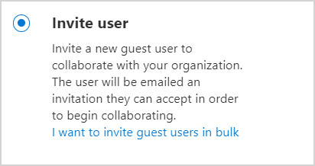
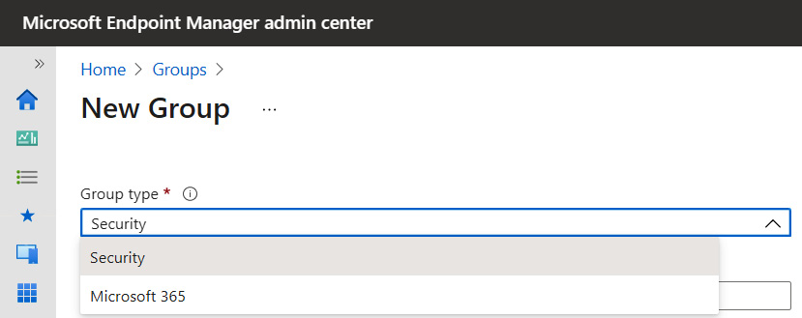
AAD guest users AAD group types
Figure 89 – Creating a new group
Notes:
AAD users
AAD users include the account settings of a user in your organization and only live in the Microsoft Azure cloud. Creating and deleting users can be done by using either the AAD Global Administrator role or an account that has the account administrator role-based access control (RBAC) role assigned.

Slide 7
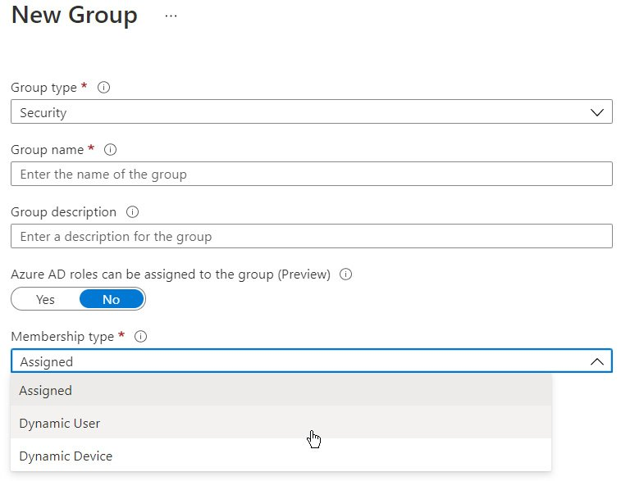
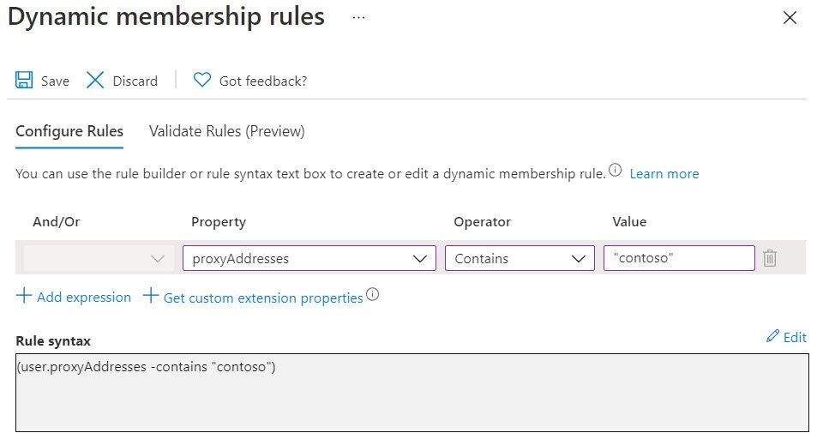
AAD membership types
Dynamic user
Dynamic device
Figure 90Creating a new group
Notes:
AAD membership types
Figure 90Creating a new group
In the previous section, we explained the differences in types of AAD groups. There are three ways to make users or devices members of an AAD group. Assigned: This is the most common way of assigning access to a specific group. You add specific users to an AAD group to gain access, for example, to a security policy.
Dynamic user: This type makes it possible to automatically add users to a group based on conditions that you define. There is no interaction needed to add – as well as remove – the users to the AAD group when the user no longer meets the requirements to be part of the group.
Dynamic device: This type is somewhat the same as the dynamic user membership type; however, now it is used to automatically add or remove devices from the AAD group.
Pick the type that fits your use case best, as dynamic membership could provide a more scalable method for larger organizations. Dynamic groups are only supported as either the user or device type – not both.
Within the dynamic membership rules, you can create complex attribute-based rules to enable dynamic membership for groups, which you could use to add and remove users from the AAD group.
Figure 91 Dynamic membership rules
For example, you can add all users that have @contoso.com as proxyAddresses configured in AAD automatically by adding the following rule. You can imagine that any number of options will be available through this approach.

Slide 8
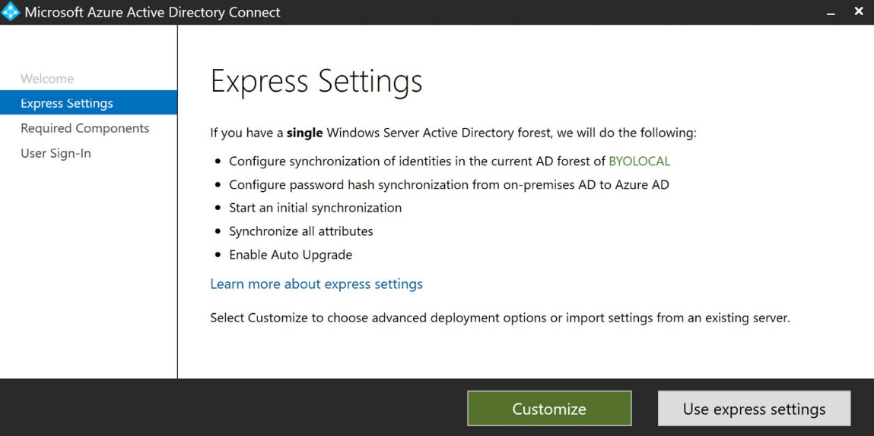
Hybrid AAD
Figure 92 – Microsoft AAD Connect – Express Settings
Notes:
Hybrid AAD
Devices that are HAADJ are part of your organization and are signed in with an AD (AD DS) account belonging to the organization. They exist in the cloud and on-premises to make the translation possible between traditional AD DS and AAD. This is needed for different scenarios within MEM as well as Windows 365.
To use hybrid AAD, you must replicate your on-premises environment to bring/sync your identities and devices to AAD. You do that with the Microsoft AAD Connect software.
Figure 92 – Microsoft AAD Connect – Express Settings
The software has been built on Microsoft Identity Management (MIM) and is preconfigured with all the configuration items to replicate your on-premises users, groups, and devices to AAD.

Slide 9

Monitoring and Endpoint Analytics

Slide 10

Module Overview
In this chapter, we'll go through the following topics:
Monitoring and analytics
Monitoring your physical and virtual cloud endpoints
Endpoint analytics – advanced monitoring
Top 10 impacting start up processes
OS restart history
Resource performance
Insights and recommendations – score trends
Application reliability
Windows 365-specific metrics
Insights and recommendations
Customizing your baselines
Productivity Score
Service health

Slide 11
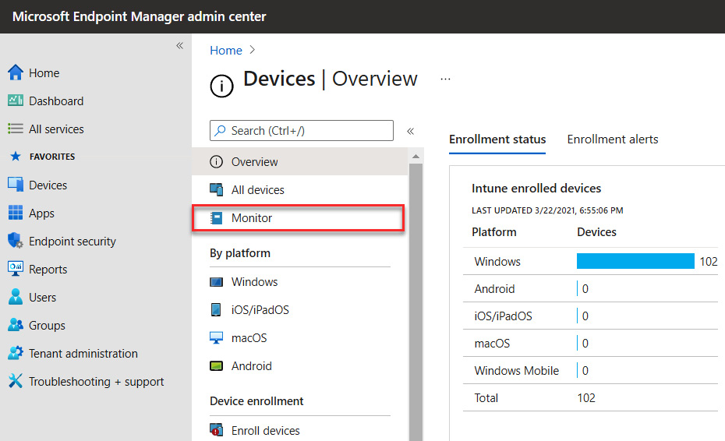
Monitoring and analytics
Monitoring your physical and virtual cloud endpoints

Slide 12
Monitoring dashboards available:
Configuration:
Assignment status
Assignment failures
Devices with restricted apps
Encryption report
Certificates
Compliance:
Non-compliant devices
Devices without compliance policy
Setting compliance
Policy compliance
Non-compliant policies
Windows Health Attestation report
Threat agent status
Enrollment:
Autopilot deployments
Enrollment failures
Incomplete user enrollments
Software updates:
Per-update ring deployment state
Installation failures for iOS devices
Feature update failures
Windows expedited update failures

Slide 13
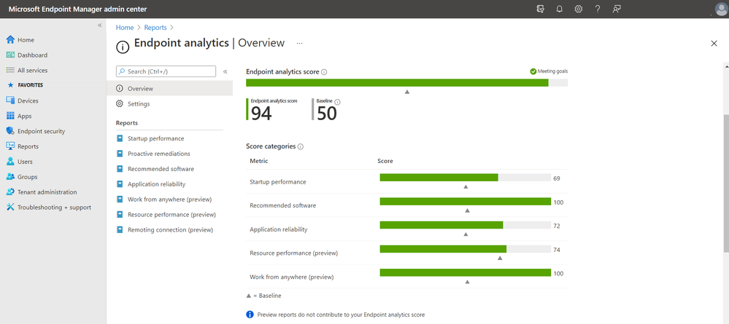
advanced monitoring
Device actions
Endpoint analytics
Endpoint analytics:
Start up performance
Proactive remediations
Recommended software
Application reliability
Resource performance
Remoting connection

Slide 14
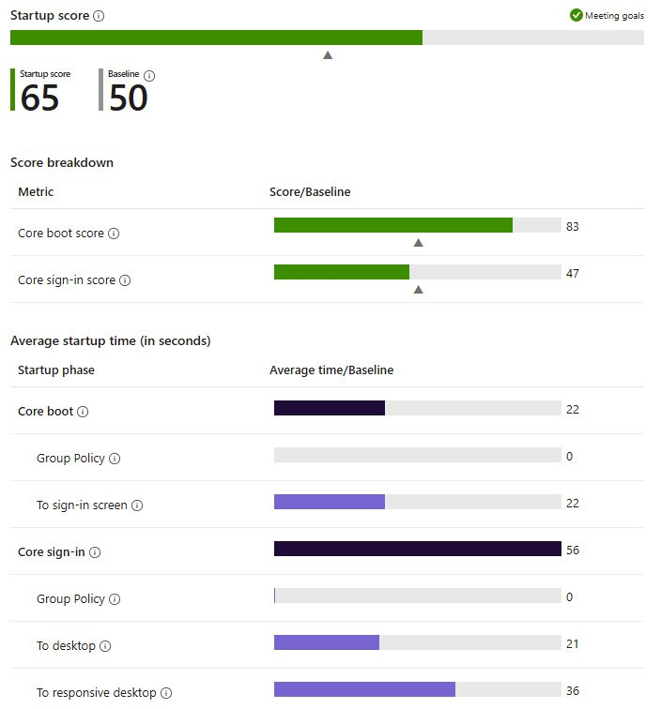
Start up performance
logon duration
Excludes the OS update time:
Group Policy
To sign-in screen
Core sign-in
Group Policy
To desktop
To responsive desktop
Notes:
Start up performance – logon duration
Improving start up performance to optimize the time from powering on your physical computer to productivity is best for consistent performance in terms of increasing the speed to productivity.
Review your current score and see how it compares to the selected baseline. Refer to the list of different insights and recommendations to learn how to improve your device start up times and score; this can be found in the Endpoint analytics dashboards.
Here's a list of the metrics available in Endpoint analytics, per organization, and per user device level, to dig deeper into specific scenarios:
Core boot: Average time it takes to reach the sign-in prompt after a device is turned on. Excludes the OS update time:
Group Policy: Average time spent processing Group Policy during the device's core boot
To sign-in screen: Core boot time minus the time spent processing Group Policy
Core sign-in: Average time it takes to get to a responsive desktop after a user signs in. Excludes new user sign-in and first sign-in following a feature update:
Group Policy: Average time spent processing Group Policy during the device's core sign-in
To desktop: Average time between sign-in and when the desktop renders, minus the time spent processing Group Policy
To responsive desktop: Average time between when the desktop renders and when CPU usage falls below 50%
The start up performance score gives the IT department insight into the end user experience from power-on to productivity. With these insights come recommendations on what to change to improve end users' experience. Next, we will cover the performance score breakdown.
Performance score breakdown
To calculate our tenant's score, we look at how long it takes each device to complete the core boot phase and score each experience from 0 (poor) to 100 (exceptional). We then calculate the average score of all devices to get the core boot score.
In the following screenshot, you can find an example breakdown of the full logon process, from booting up and the logon process of your physical, to even further in your cloud PC, your Windows 10 Enterprise endpoint.

Slide 15
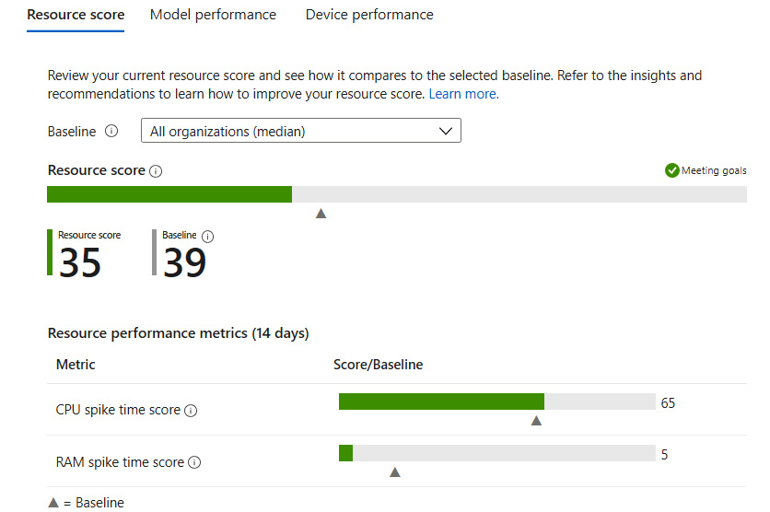
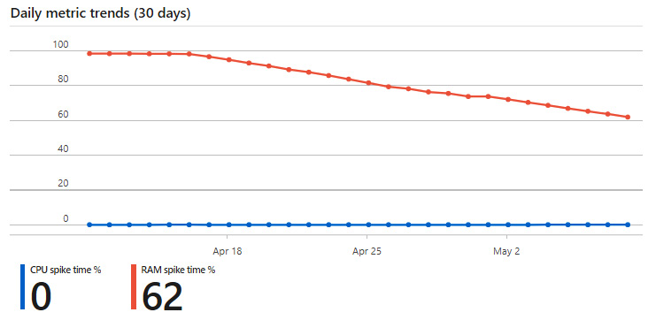
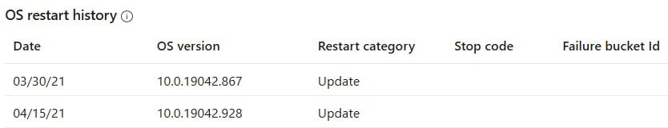
History, Performance and Insights
Notes:
OS restart history
Last but not least, you can also find the restart actions on each physical and cloud PC in the last section of the dashboard:
Figure 14.12 – OS restart history
Resource performance
In this dashboard, it's possible to see the application events on your physical and cloud PCs. This gives you insights into one of the most important indicators of bad user experience – CPU and RAM utilization.
Figure 14.13 – Resource utilization
Insights and recommendations – score trends
It's also possible to see the last 30 days of resource consumption and whether there's a trend. This would make it easy, when you provide a fix, to see whether the improvement affects all your users.
Also, the other way around, when issues occur or you install an update that requires way more resources than before, you can start correlating your results with the time of enrollment of that patch or update. Very insightful.

Slide 16
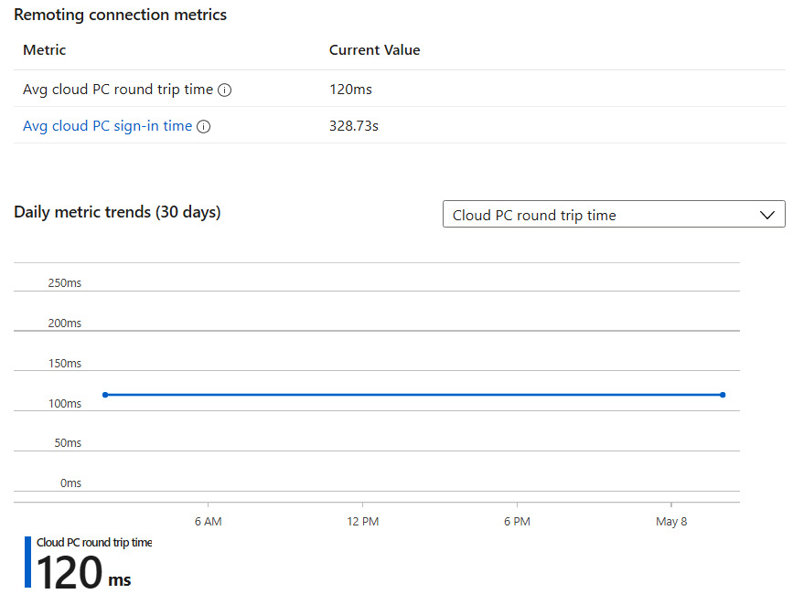
Windows 365 metrics
Resource performance:
CPU spike time percentage
RAM spike time percentage
Remoting connection:
RD client login time
RD client login failure
Round Trip Time (RTT)

Slide 17

Universal Print
Module 13

Slide 18

Chapter Overview
In this chapter, we'll go through the following topics:
What is Universal Print?
Configuring Universal Print

Slide 19
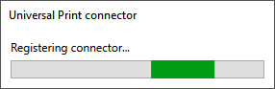
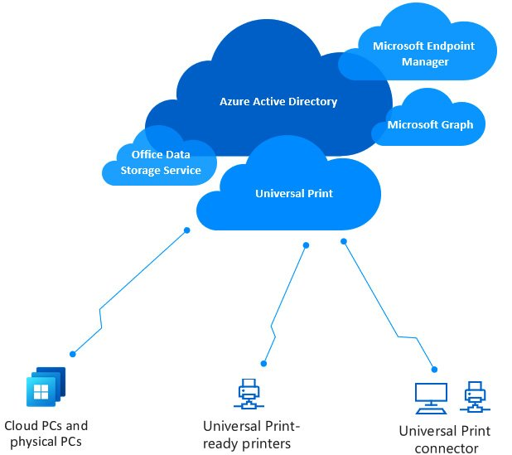
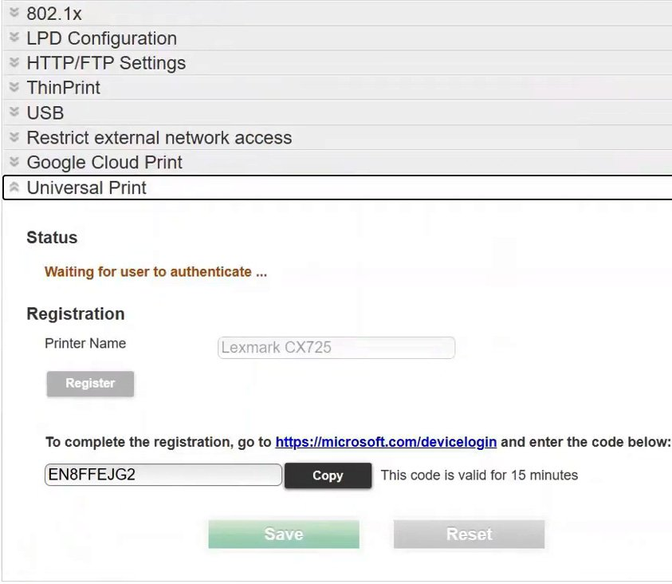
What is Universal Print?
Universal Print architecture
Notes:
Universal Print is a new cloud-based print solution that allows IT admins to share printers through the cloud. Universal Print eliminates the need for on-premises print servers and lets you easily manage and deploy printers directly with Microsoft Endpoint Manager to use them as part of your cloud and physical desktops.
It enables you to manage printers directly through a centralized portal in Microsoft Azure. Say goodbye to installing (and maintaining) printer drivers on devices and/or base images. Also, everything works with Azure Active Directory (AD). This means that users can use the same set of credentials they use for other Microsoft services, whether they log on to a physical or a virtual desktop running in the cloud.
Another great benefit of the service is that you most likely already have the licenses –most customers that are eligible to use Microsoft Endpoint Manager also get Universal Print licenses. You can find the licenses you need for Universal Print in the requirements section later in this chapter.
Universal Print – architecture explained
The core print services run in the cloud as a platform service running on Azure, while the Universal Print connector(s) must be installed on a device running Windows Server or the Windows client OS. The connector device may be a physical device, virtualized on-premises, or hosted on Azure:
Figure 15.1 – The architecture of Universal Print – used with permission from Microsoft
When your printer is Universal Print-ready, you can then connect the printer directly to the cloud! There's no need for an ExpressRoute or a site-2-site VPN connection in all scenarios. Did you share and connect your printers correctly? You can then start assigning printers via Microsoft Endpoint Manager to your virtual (and physical) Windows 10 Enterprise desktops!

Slide 20
Universal Print requirements
Universal Print:
Your desktops should be joined to Azure AD. Hybrid AAD joined (HAADJ) device physical and virtual desktops are also supported.
An eligible Microsoft 365 or Windows SKUs license.
Universal Print licenses assigned to the Azure AD tenant via the Global Administrator.
A Universal Print supported printer that can connect directly to the cloud – without a connector.
A normal USB or network printer (via a connector).
To configure Universal Print, the administrator doing the work should have either the Printer Administrator Azure AD role or should just be the Global Administrator.
A Windows 10 client device – on version 1903 or later.
A Universal Print connector host.

Slide 21
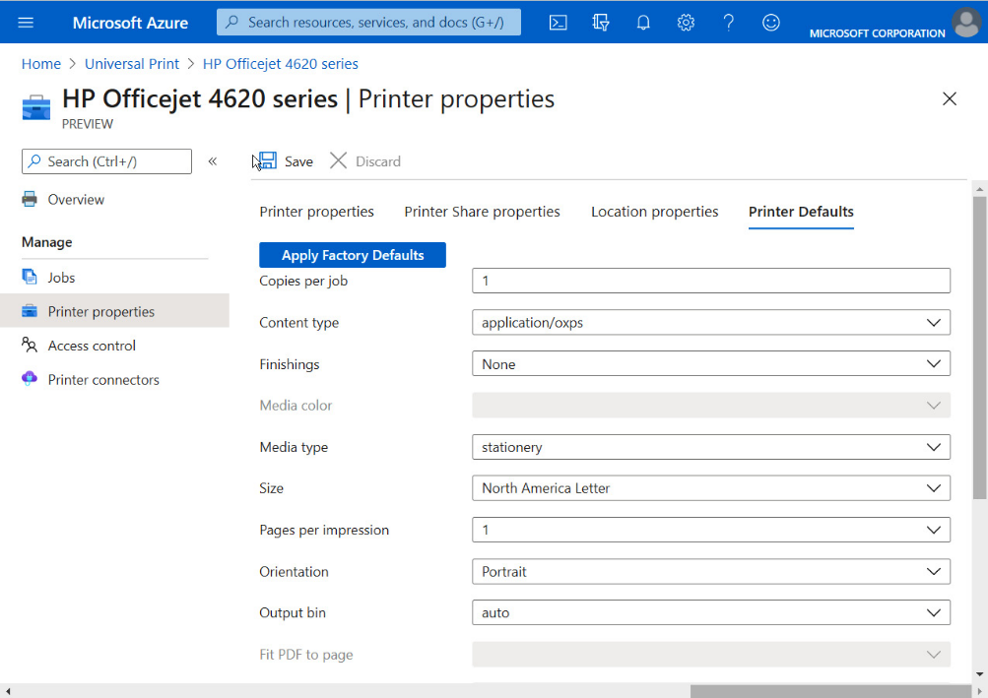
Deploy Universal Print
Network requirements
Universal Print service URLs:
https://login.microsoftonline.com
https://aadcdn.msftauth.net
*.print.microsoft.com

Slide 22
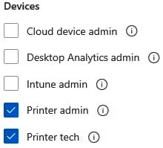
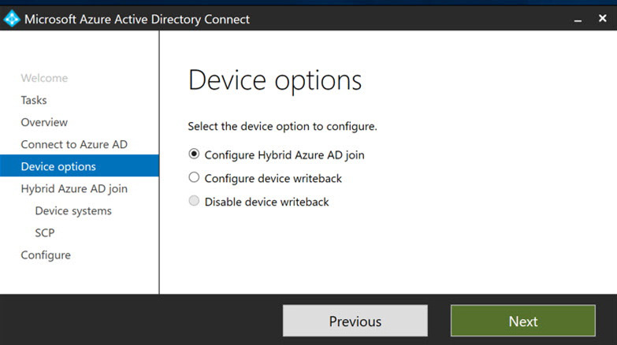
Delegating printer access
partner solutions:
Brother
Canon
Celiveo 365
The ezeep Hub by ThinPrint
HP Workpath
Kofax ControlSuite
Konica Minolta
Kyocera
Lexmark
MPS Monitor
MyQ X
PaperCut
Pharos Beacon
PriApps
Printix SaaS
Ricoh
Toshiba
uniFLOW Online
Xerox Workplace Cloud
YSoft

Slide 23
Review

